Slide 1
IT11L COMPUTER NETWORK LESSON 2

Slide 2
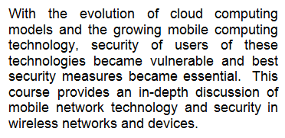
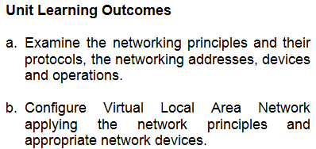
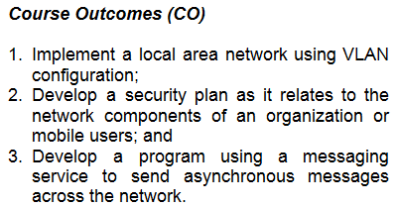
COMPUTER NETWORK 2

Slide 3
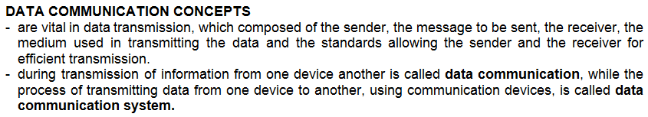
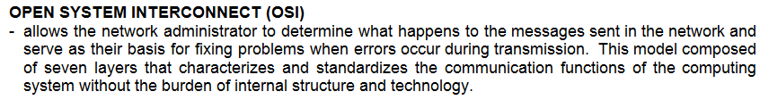
COMPUTER NETWORK 2 METALANGUAGE

Slide 4




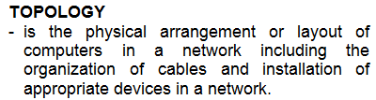

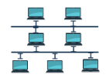


COMPUTER NETWORK 2 METALANGUAGE

Slide 5


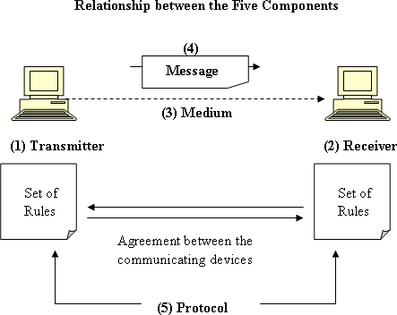

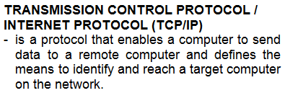
COMPUTER NETWORK 2 METALANGUAGE

Slide 6
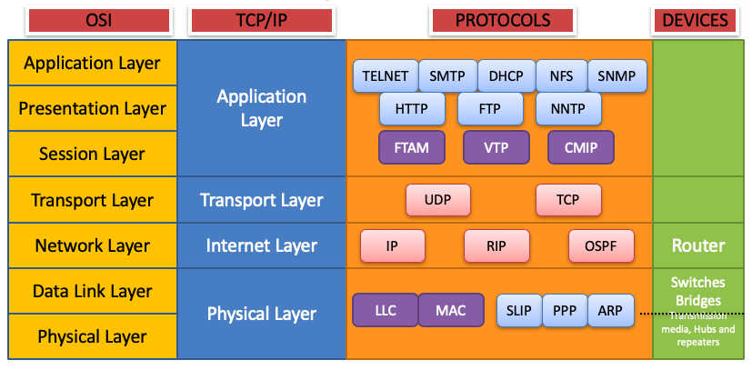
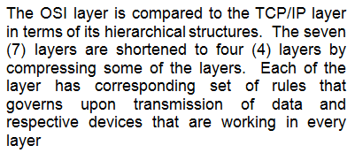
COMPUTER NETWORK 2 METALANGUAGE

Slide 7


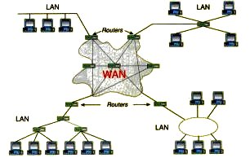
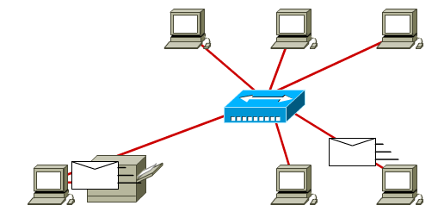
COMPUTER NETWORK 2 METALANGUAGE

Slide 8

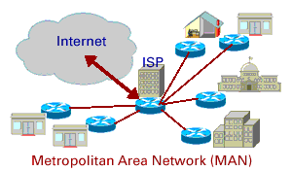
COMPUTER NETWORK 2 METALANGUAGE

Slide 9
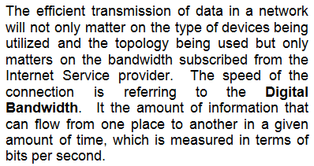
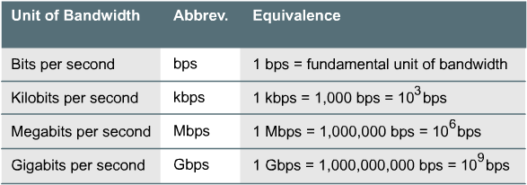
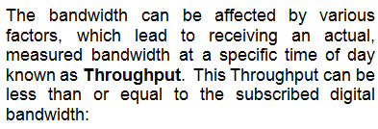
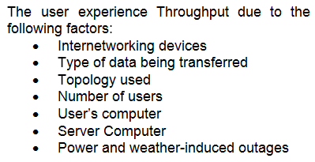
COMPUTER NETWORK 2 METALANGUAGE

Slide 10

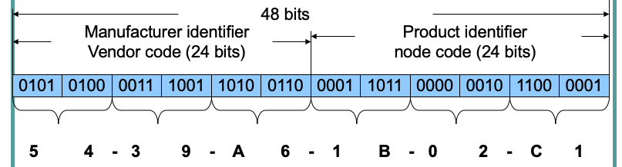
COMPUTER NETWORK 2 METALANGUAGE

Slide 11
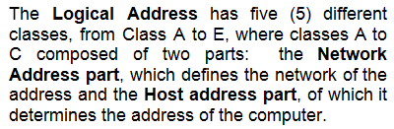
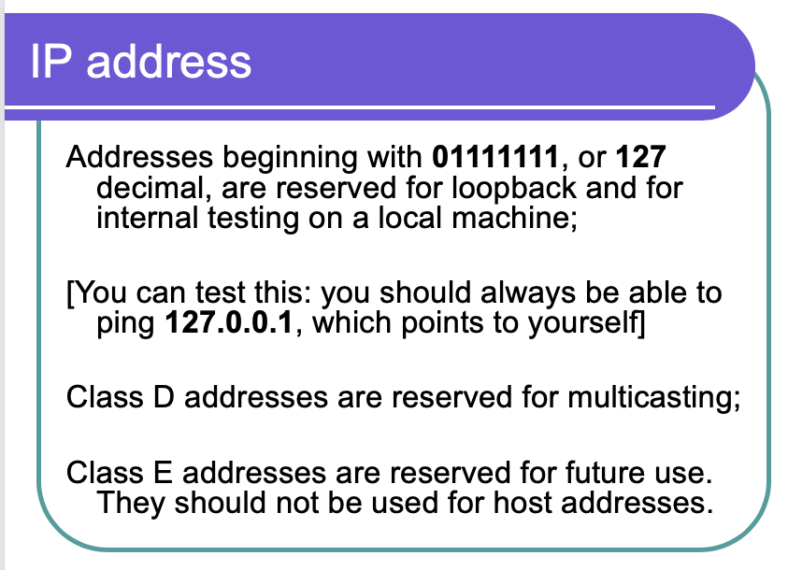
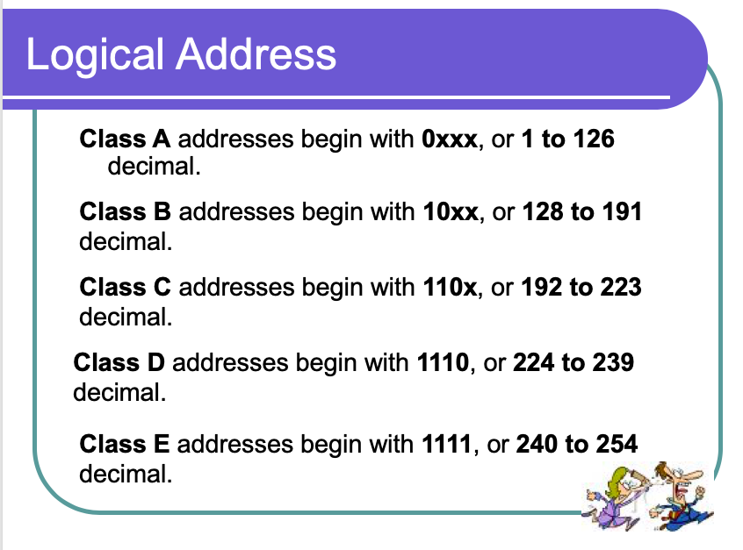

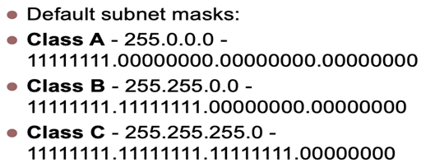
COMPUTER NETWORK 2 METALANGUAGE

Slide 12

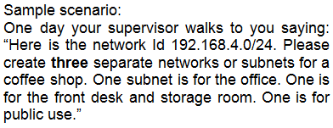


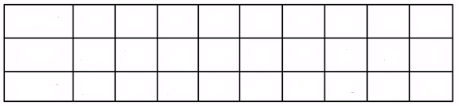

COMPUTER NETWORK 2 METALANGUAGE

Slide 13

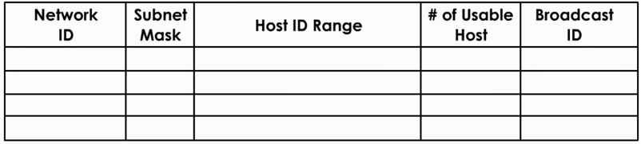
COMPUTER NETWORK 2 METALANGUAGE

Slide 14
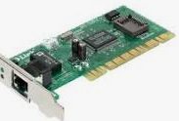


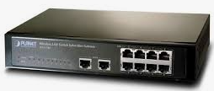
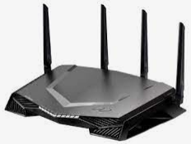









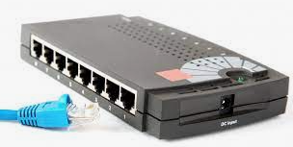

COMPUTER NETWORK 2 METALANGUAGE

Slide 15
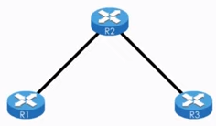




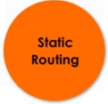




COMPUTER NETWORK 2 ROUTING PROTOCOLS

Slide 16
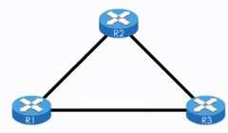

COMPUTER NETWORK 2 ROUTING PROTOCOLS

Slide 17
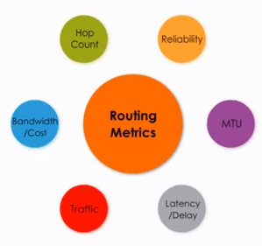






COMPUTER NETWORK 2 ROUTING METRICS

Slide 18
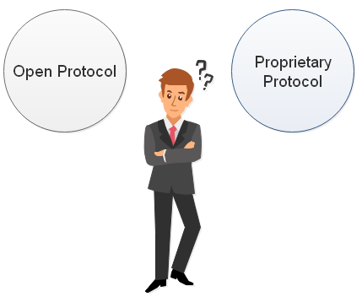
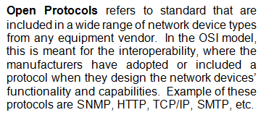
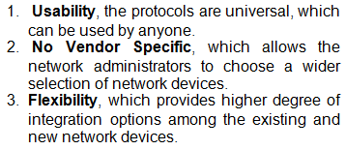
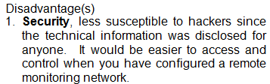
COMPUTER NETWORK 2 OPEN VS PROPRIETARY PROTOCOLS

Slide 19



COMPUTER NETWORK 2 OPEN VS PROPRIETARY PROTOCOLS

